Slide 1
Cartograms bad
Paulina Tomaszewska
Jan Sawicki

Slide 2
A cartogram
A map in which some thematic mapping variable (...) is substituted for land area or distance
~ Wikipedia

Slide 3
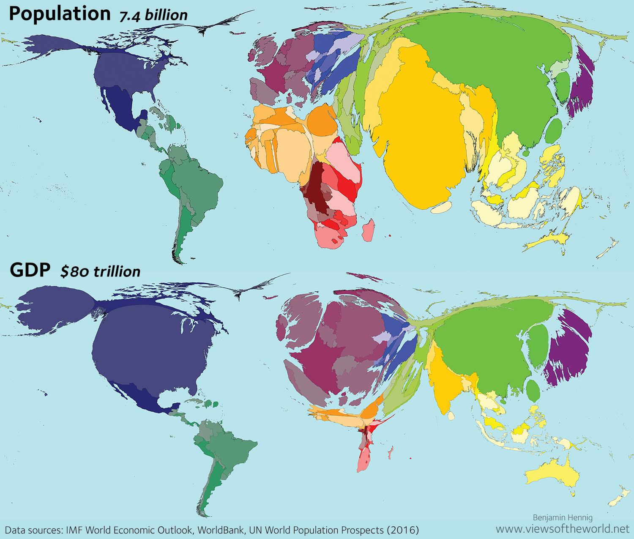

Slide 4
A cartogram
A map but bad.
~ anyone with eyes

Slide 5
Why are they bad?

Slide 6
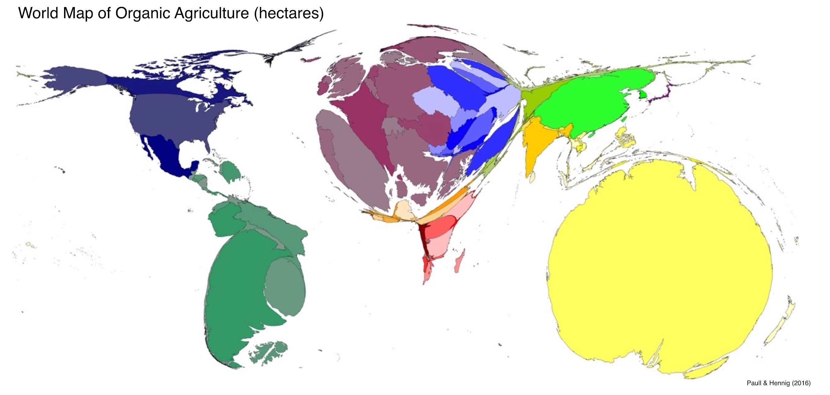
wHy aRE tHeY bAd?

Slide 7
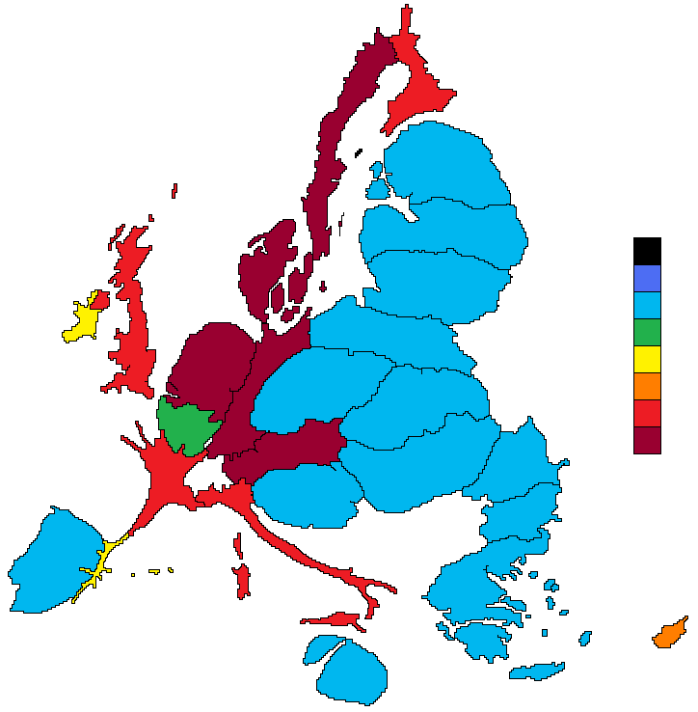
wHy aRE tHeY bAd?

Slide 8
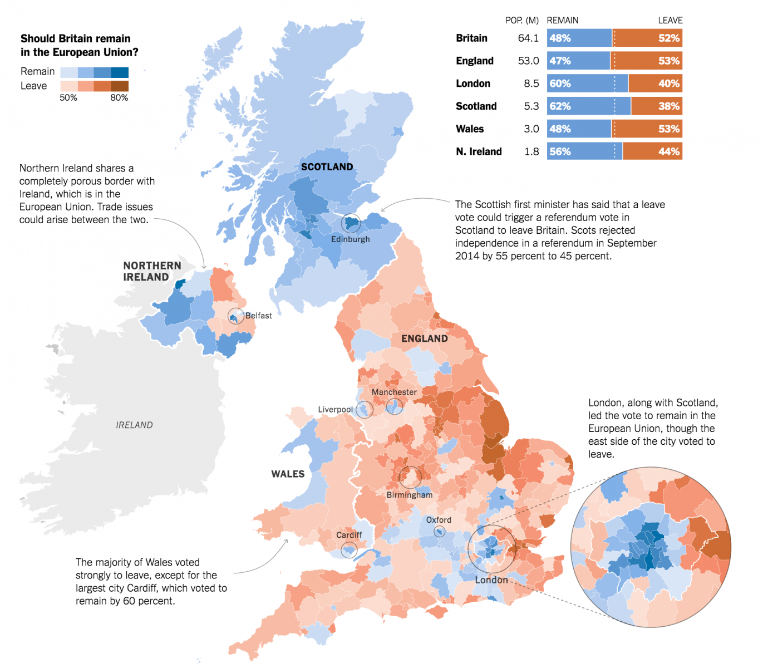
Map with colors good

Slide 9
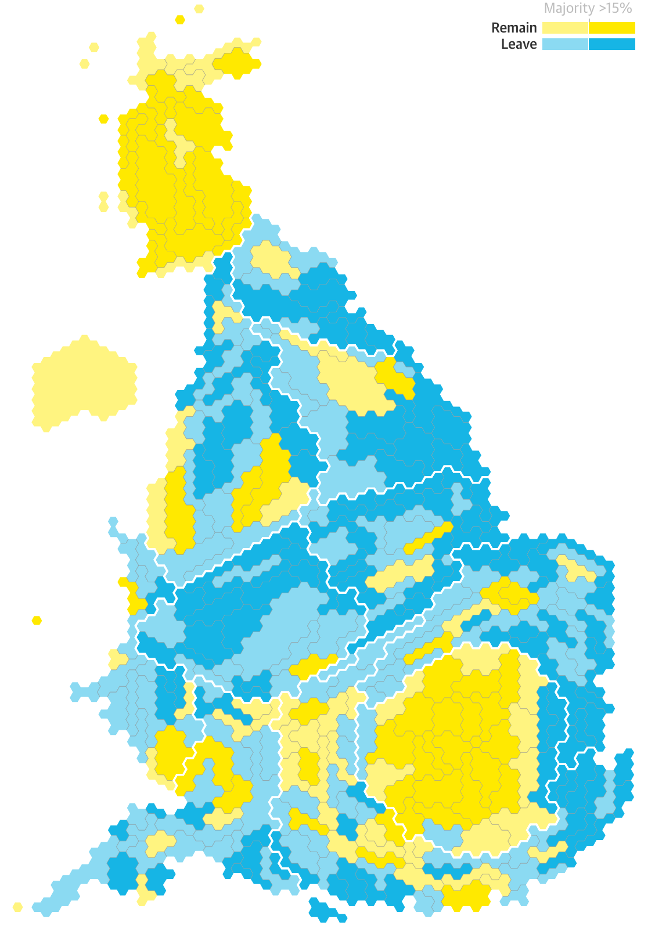
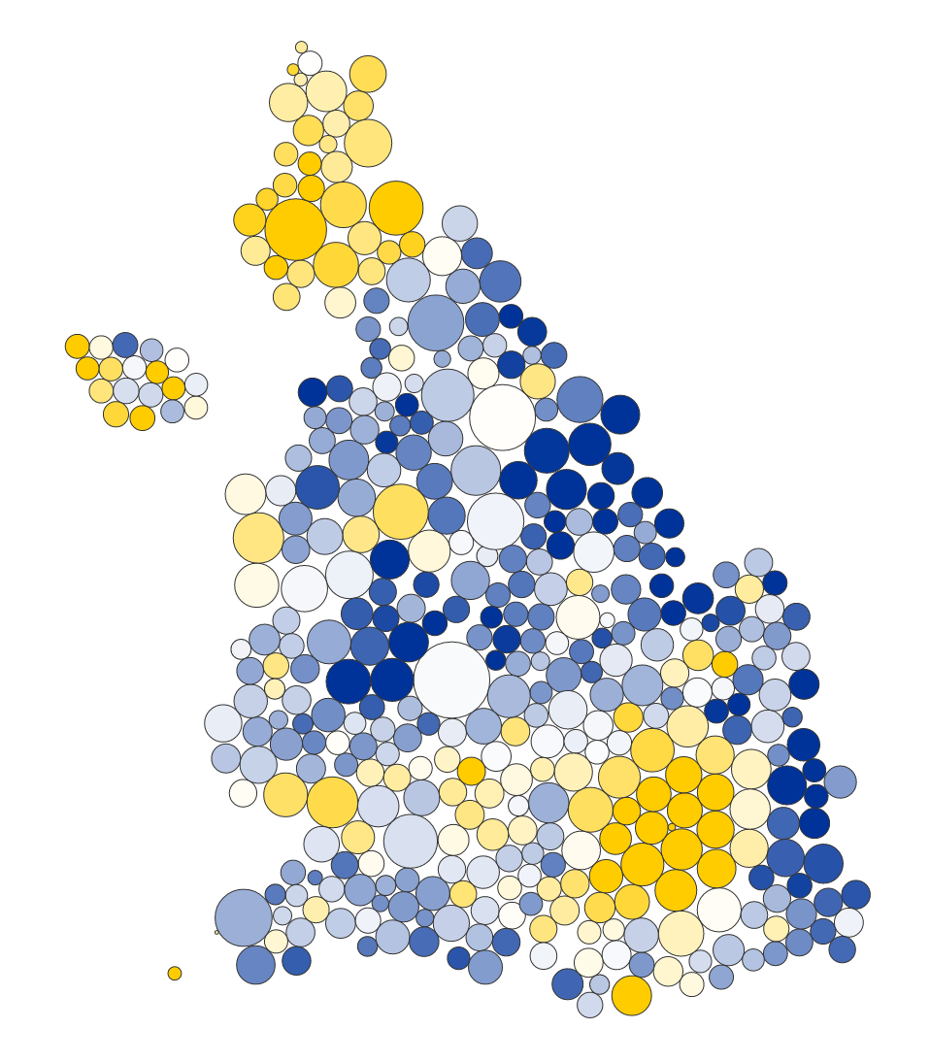
Cartogram bad

Slide 10
Why are they bad?
This country is… Europe, right?
Which one is bigger?
You used a map to show something that is NOT a map?
That’s N/A or 0?
Is there any other way to show it?

Slide 11
Why are they bad?

Slide 12
Is there any other way to show it?
Use a table
Use a bar chart
Use colors on a map
… use a 3D charts

Slide 13
Cartograms
Just don’t.
Paulina Tomaszewska
Jan Sawicki

Slide 14
Sources
Content
https://www.vis4.net/blog/2016/06/to-cartogram-or-not-to-cartogram-the-brexit/
https://en.wikipedia.org/wiki/Cartogram
Graphics
https://upload.wikimedia.org/wikipedia/commons/d/d1/PaullHennig2016WorldMap.OAha.CC-BY-4.0.jpg
https://upload.wikimedia.org/wikipedia/commons/d/df/EU_net_budget_2007-2013_per_capita_cartogram.png

Slide 15
CREDITS
Special thanks to all the people who made and released these awesome resources for free:
Presentation template by SlidesCarnival
Photographs by Unsplash

